Slide 1
Track 4 - Automations with AI: Build Agents that Sense, Decide, and Act to Automate Real Task
Moldovan Luca
Moldoveanu Virgiliu-Stefan
Manolescu Neacsu Andrei

Slide 2
Links
https://github.com/moldovanluca4/Automation-with-AI-Build-agents-that-sense-decide-and-act-to-automate-real-tasks
https://encouraging-onion-589.notion.site/Welcome-to-our-Hackathon-Project-2b5736480c6b801b91b4f601529f7a1a

Slide 3
Market Research Automation Agent
Discovery: Automatically searches blogs and articles to identify competitor websites and URLs.
Cleaning: Uses Pandas to filter out broken links, garbage data, and irrelevant domains (like login pages).
Data Enrichment using Linkedin: Locates company LinkedIn profiles and scrapes structured data like Headquarters, Company Size, and Industry.
Sentiment Analysis: Scrapes forums for "pros and cons," user complaints, and authentic reputation data.
Consolidation: Merges all gathered data into a single master database table for analysis.
Data Migration & Integration: Custom scripts migrate the consolidated data from the local embedded database to Google Sheets for further processing in n8n workflows. These migration scripts are excluded from the public repository for security purposes as they contain personal Google API credentials.

Slide 4
N8N INTEGRATION
What is N8N?
Open-source, node-based workflow automation tool that allows users to visually build workflows
Why did we choose N8N?
N8N bridges the gap between raw code and business logic, creating a seamless hybrid workflow
How does the workflow look like?

Slide 5
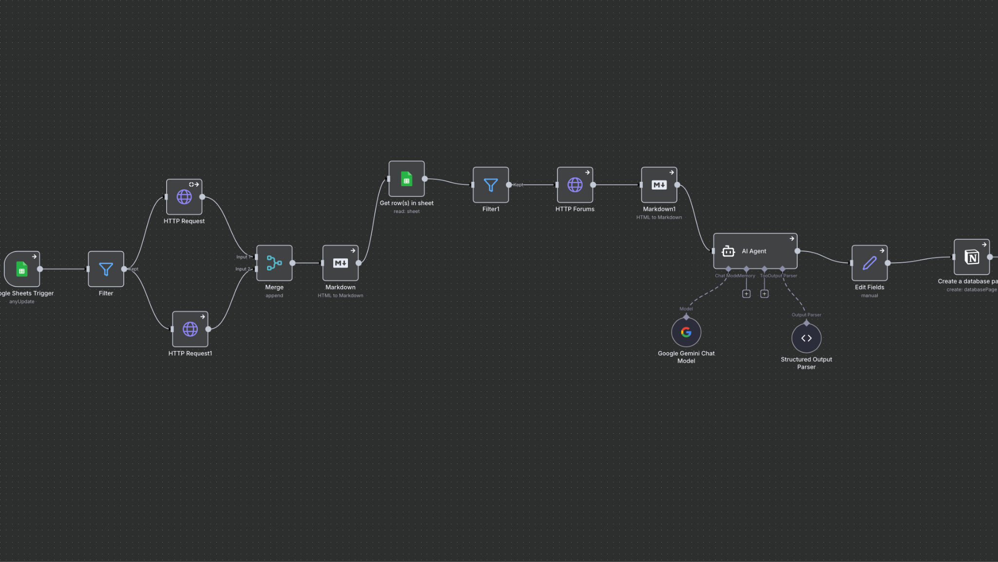
B
C
A
A,B = Output from Python
C= AI Agent Node

Slide 6
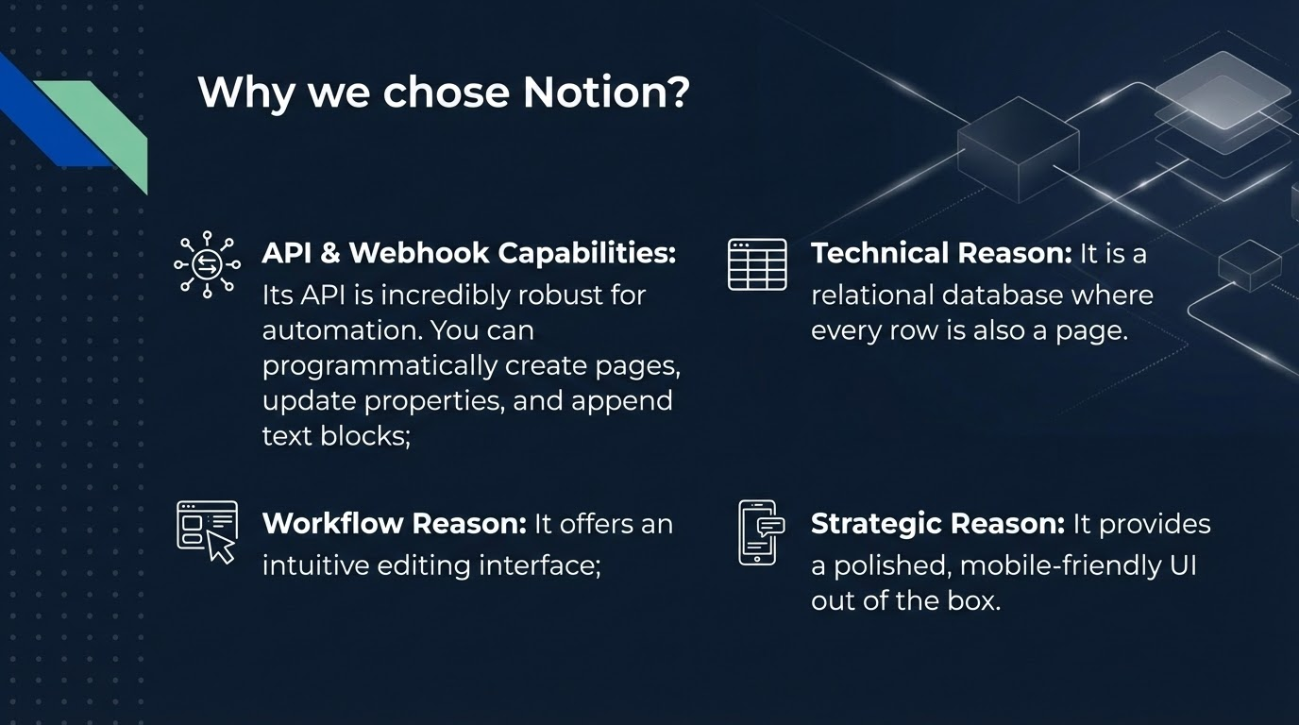

Slide 7
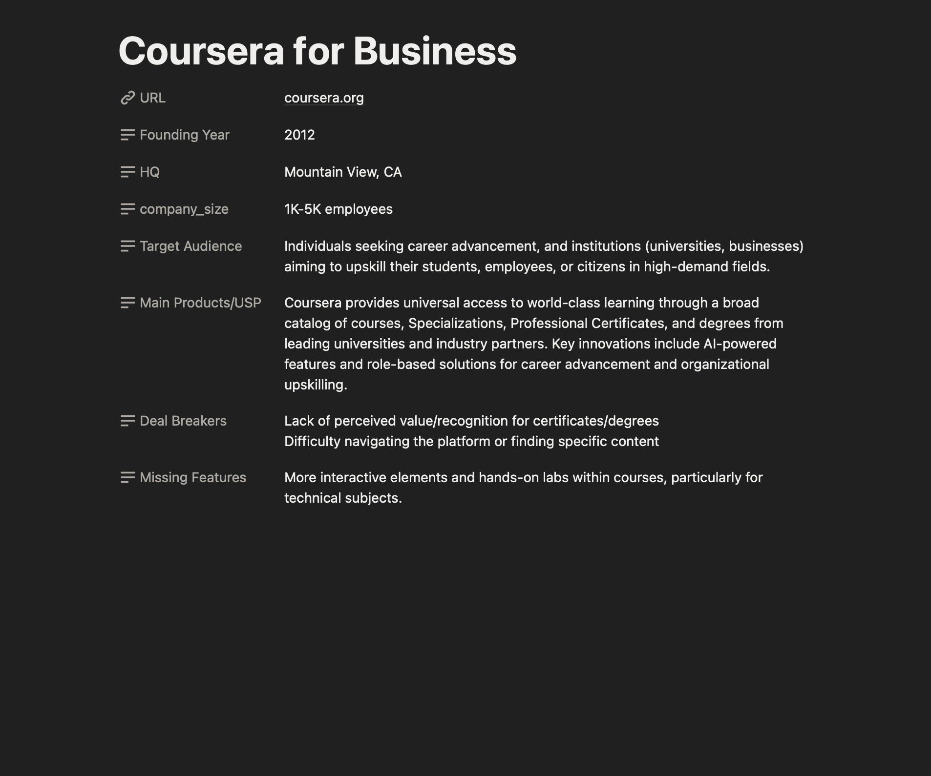

Slide 8
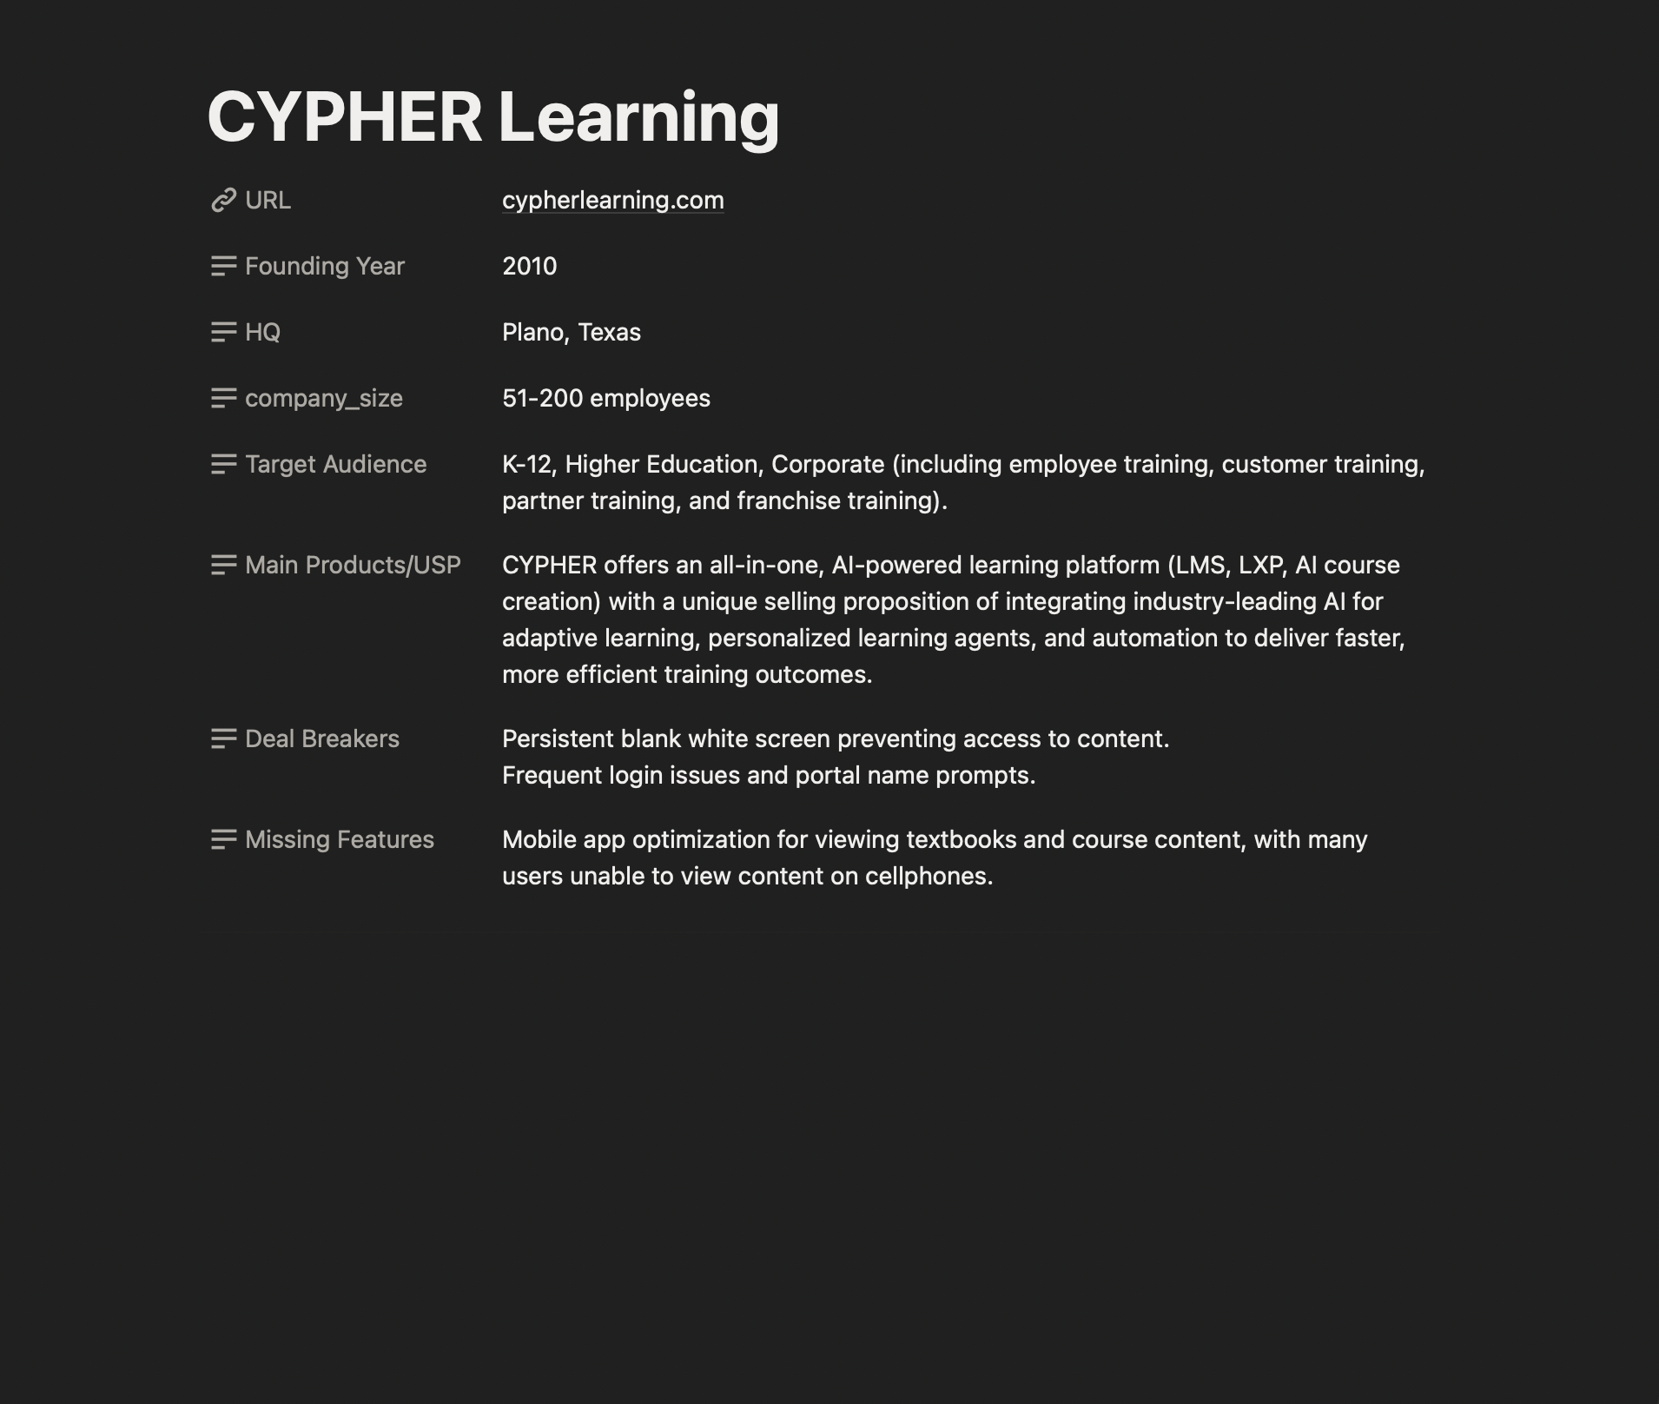

Slide 9
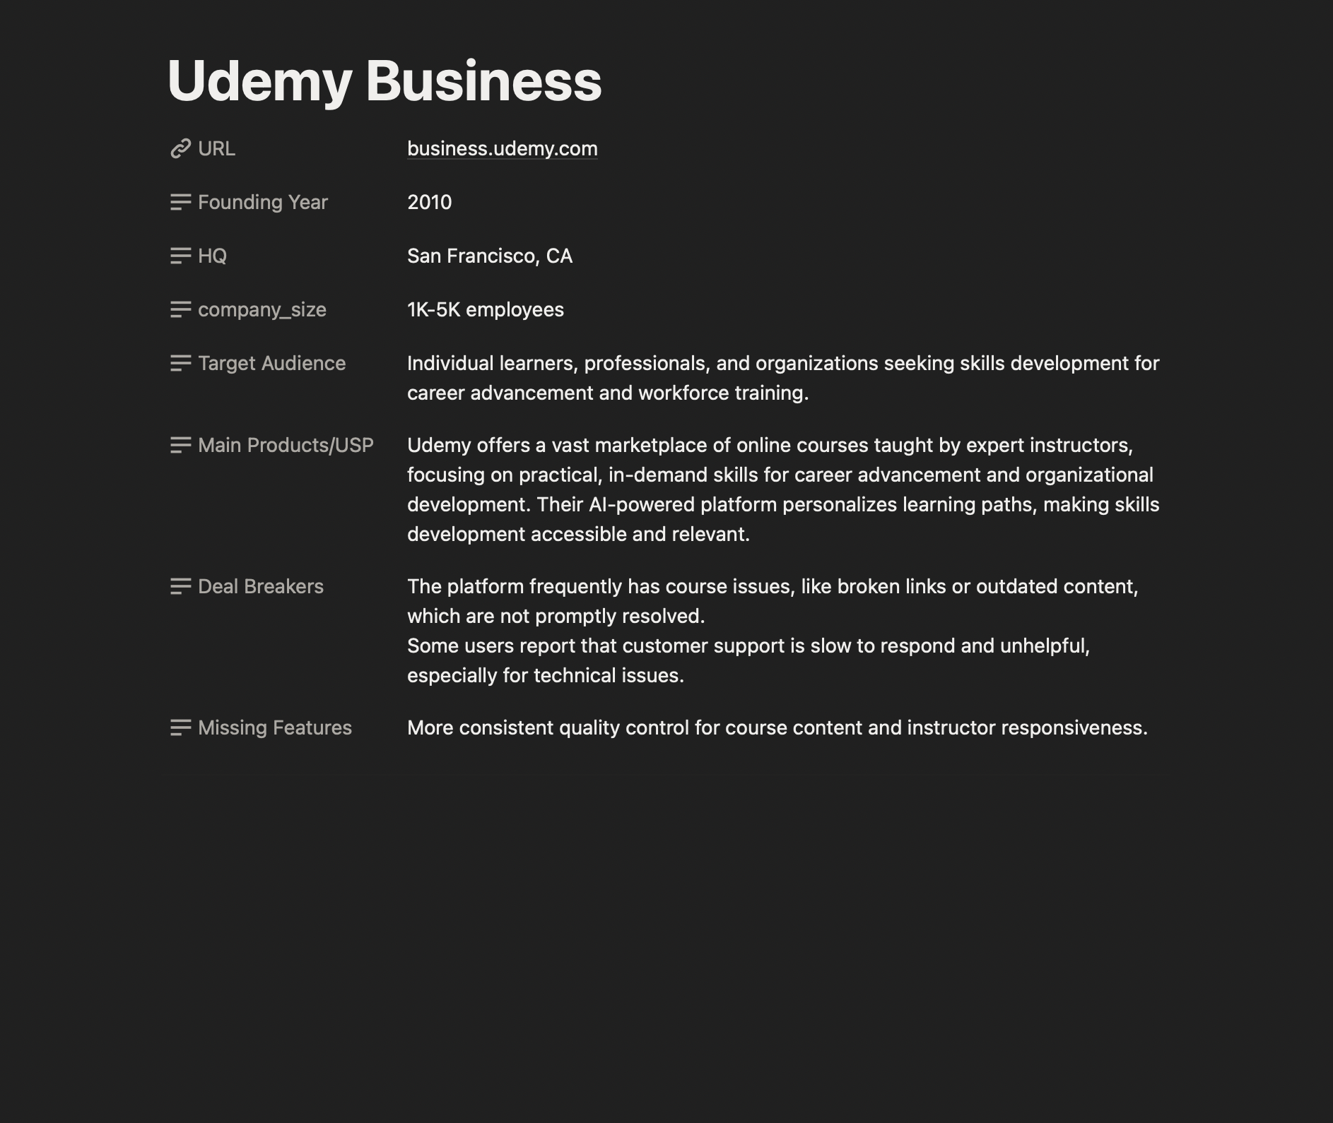

Slide 10
Thank You!

